Slide 1
Programming Language Orientation

Slide 2
Algorithm vs. Program
Algorithm: the sequence of steps to solve a problem
Abstract
Not tied to a language
Program: a sequence of commands in a computer language
Precise syntax
Implements an algorithm
Notes:
Let's start with some important vocabulary. In this course, we’ll often use the word algorithm.
An algorithm is a plan for solving a problem. You can think of it as a strategy. It’s abstract, meaning that it’s not tied to any language. you can express an algorithm in a programming language like python or java, or you can express it in English.
Once you encode an algorithm into a programming language like python, you can call it a program. A program is any sequence of commands to be executed by a computer. Unlike an algorithm, it has a very precise syntax.

Slide 3
An Example Problem
Make x cents of change with dimes and pennies
Algorithm
Start with zero dimes
Check if x is more than 10. If so, do the following:
Add one dime
Subtract 10 from x, and remember that as the new x
Go back to the beginning of step 2
However, much is left in x, make that the number of pennies
Notes:
Here’s an example of a problem. you need to give someone x cents of change, and you want to know how many dimes and how many pennies to give them.
Most of the time, when you have a problem to solve, you won’t start writing python. First you need to think of the algorithm - the sequence of steps. I think it’s often helpful to think of how you would explain this to another human - but be very precise - you have to tell the human exactly what to remember.
Here’s one algorithm we could use….

Slide 4
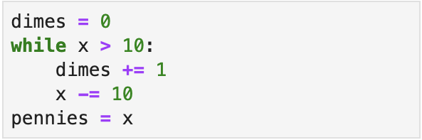
A Program in Python
Make x cents of change with dimes and pennies
Notes:
So obviously, we'll use computers to help us with these tasks. And a program is the set of instructions that will pass to the computer to tell it what to do. So I think it's helpful, at this point, to actually distinguish between the steps that we need to take to solve a problem, as opposed to the instructions themselves.

Slide 5
High-Level vs. Low-Level Languages
High level
Abstract away computer details
Close to human language
Fast development
Low level
Offer control over memory allocation, CPU operations, etc.
Hard to read by humans
Fast execution
Notes:
Low level languages are powerful
Requires programmer to know about the hardware the code is running on.
More details to worry about
More code to write.
More places to make mistakes.

Slide 6
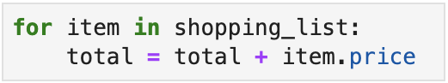
Spectrum of Languages
High level
R, Perl, Visual Basic, Ruby, Javascript, Go, Python
Java
C/C++
1010101010100101001010100111001011001001101001010101010010111001010011100010100101010101101010101011010101010110
Machine code
Low level
Notes:
There's actually a spectrum of languages that really range from low level to high level language. And it's interesting that the higher up you go in the spectrum in levels of abstraction, the more choices you actually have for the language that you want to use.
So at the very bottom, there's something called machine language. This is the code that's executed by a computer, a CPU, a Central Processing Unit. You can’t read it directly - it’s just a sequence of zeroes and ones. Only very specialized programmers work at this level, and they generally work in a slightly higher level language called assembly language that gets translated to machine code.
Then, a little bit above that in this spectrum, we have languages like C and C++. These are higher level but still give you a lot of low level control. A lot of performance-oriented work takes place today in C++.
A little bit above this, we have the language Java. This is similar in many ways, but it's a bit higher level. And it's very popular. And then if you go to still higher level languages, there's actually a proliferation of languages to choose from. And these languages include Python.
You can see a bit of Python code here, and it’s often so close to human language that you can figure out what it means without any training at all. This is one reason that Python is a great language for early programmers.

Slide 7
Interpreted vs. Compiled Languages
Interpreted
Source code
Interpreter
Output
Compiled (Java, C, etc.)
Source code
Compiler
Object/ machine code
Machine/ virtual machine
Output
Notes:
Let’s talk about interpreted versus compiled languages. These terms are subject to a lot of debate, but I want to tell you a little about them.
In a strictly interpreted language, the code is ready to be executed just as it is. But it’s not in machine language, so your computer can’t execute it directly. Instead, there’s a program called an interpreter, which reads the code and follows the instructions. Interpreted languages have some advantages - they are generally independent of the computer and operating system. They are also flexible.
A compiled language is different. In a compiled language, the first step is to translate the code. It can be translated to machine code, or it can be translated into some lower level language. In java, it’s called object code. Then the translated code gets executed, and because it’s low level, it can be executed very quickly. So compiled languages are considered high performance.
So what about Python? Most of the time, python is called an interpreted language. But that’s not 100% accurate. There is actually a compilation step, and python is translated to bytecode. Most of the time, you won’t notice this, but it helps to make python more efficient.

Slide 8
Advantages of Python
High-level syntax is easy to learn
Can execute a program, or interact with user by interpreting one command at a time
Great packages for data wrangling, matrix computation, machine learning
Good packages for classical statistics
Fast, but as fast as C or Java
Elegant style
Notes:
Now that we have some vocabulary, let’s list a few advantages of python.
as an interpreted language (even if that’s not 100% true), python can interact with the user. you can type in one command, get output, then add the next command.
Finally, python is elegant. It has a visual style that’s simple, without a lot of special symbols or boilerplate. It’s organized in a way that’s consistent and transparent. And for those reasons, developers really enjoy working in python. I think after this course, there’s a good chance you will too.

Slide 9
Programming Language Orientation

